Slide 1
Jira guide
Registration and creation of tickets

Slide 2
How to register to javaguru jira?
1. Go to http://87.246.137.196:8081/login.jsp
2. Select creation of new account option
3. Fill in all mandatory fields
4. Create the account with short username and with remembered password
5. Login to Jira using username and password
6. Select languages of Jira (English is must have)
7. After filling all needed configuration please select explore projects option

Slide 3
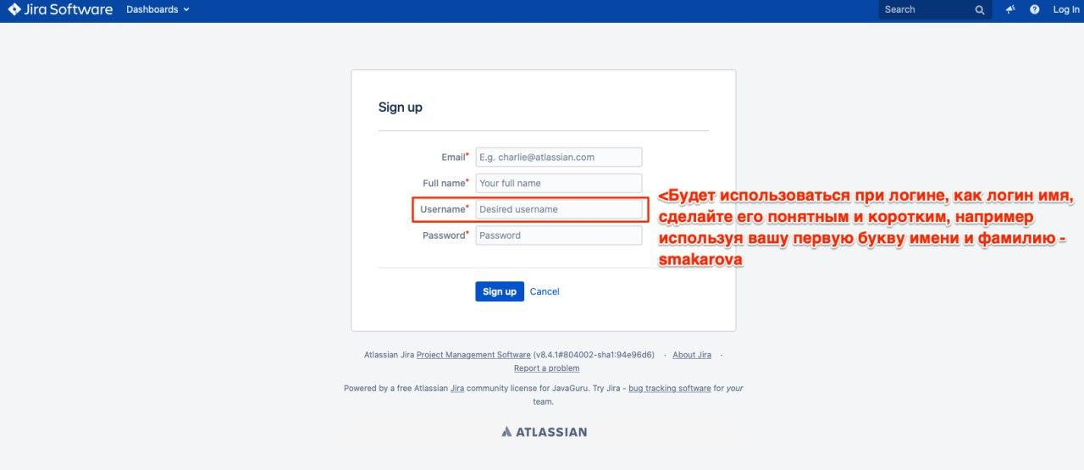
Registration details screenshot
Fill in all mandatory fields
Click on Sign up

Slide 4

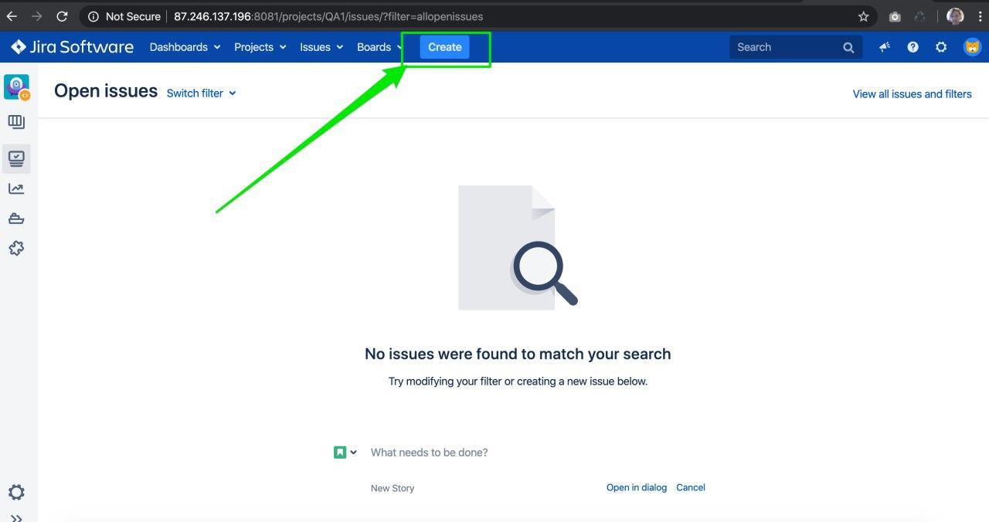
How to create the bug-report

Slide 5
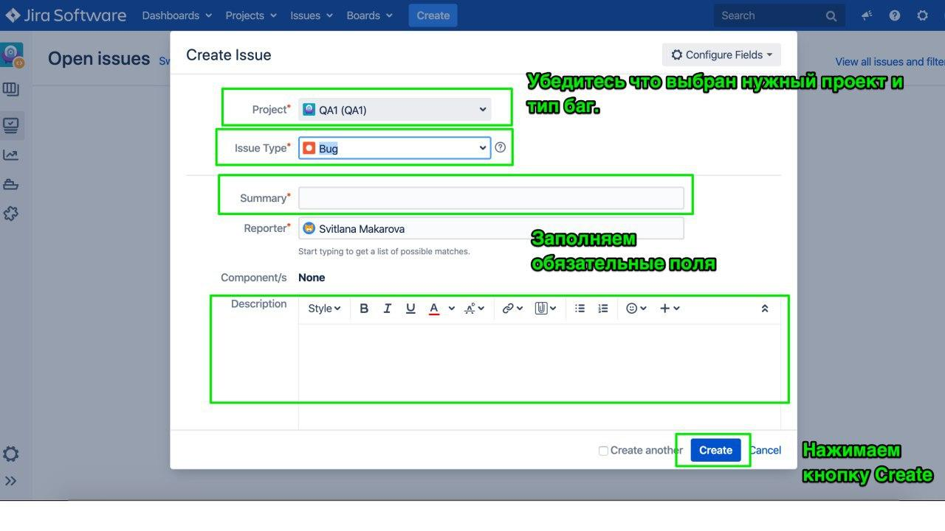
Mandatory fields for bug-report
Select correct project
Select correct issue type
Fill in Summary Where, What`s happens, When
Fill in Actual result
Fill in Expected result
Select correct Priority\severity

Slide 6
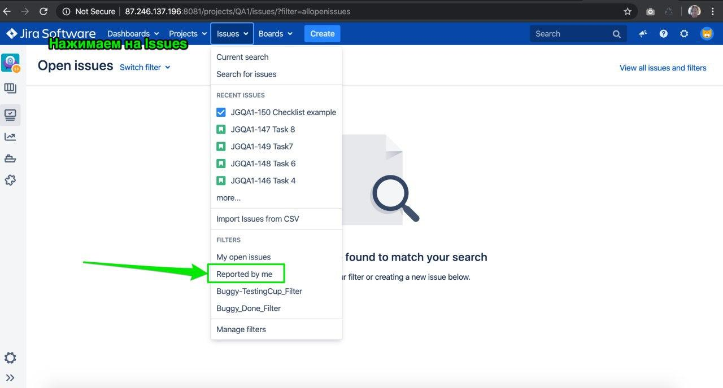
How to find the created ticket
Click on Issues in top menu
Select Reported by me option

